Slide 1
NonChord Tones 1
October 31, 2016

Slide 2
Nonchord Tones
We have already seen many nonchord tones (NCT) so far this semester.
We have been putting each NCT in parentheses, and leaving it at that.
Now we will take a closer look at NCTs
Nonchord Tone: a tone, either diatonic or chromatic, that is not a member of the chord.
can be an NCT for its entire duration
can be an NCT for only a portion of its duration, if the harmony changes before the tone does.

Slide 3

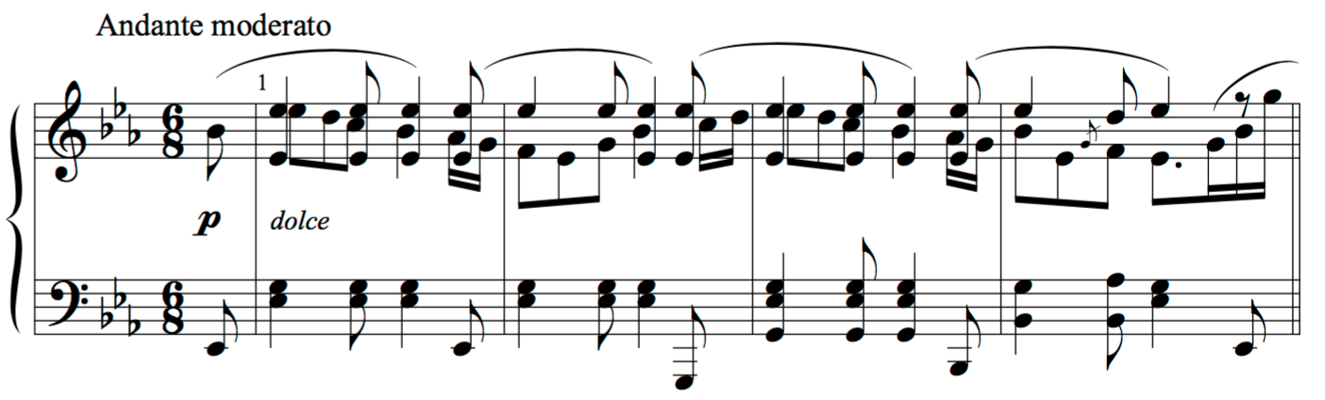
Brahms, Intermezzo in E-flat Major, op. 117 no. 1
Notes:
Let’s look at this example and do a quick harmonic analysis and find the NCTS. Do the paretheses only.

Slide 4
Classifying NCTs
NCTs are classified by the way in which they are approached and left.
Think melodically
What are the possible ways a note could be approached or left?
Step
Leap
Same tone
This can be further extended:
Step
Up
Down
In the same direction as the approach
In the opposite directions as the approach.

Slide 5
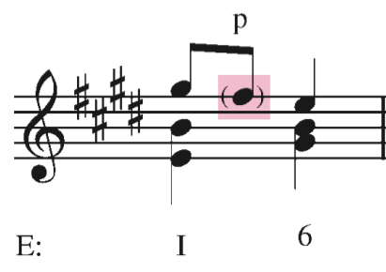
Passing Tones
The passing tone is used to fill in the space between two other tones.
A passing tone is approached by step and left by step in the same direction
Often fills in a major or minor third with whatever scale degree is in between.
Put the note in parentheses, and label with a p
Further descriptors:
Ascending/descending
Diatonic/chromatic
Accented/unaccented
Unaccented, diatonic, descending passing tone

Slide 6
Brahms, Intermezzo in E-flat Major, op. 117 no. 1
Notes:
Let’s look at this example and do a quick harmonic analysis and find the NCTS. Do the paretheses only.

Slide 7
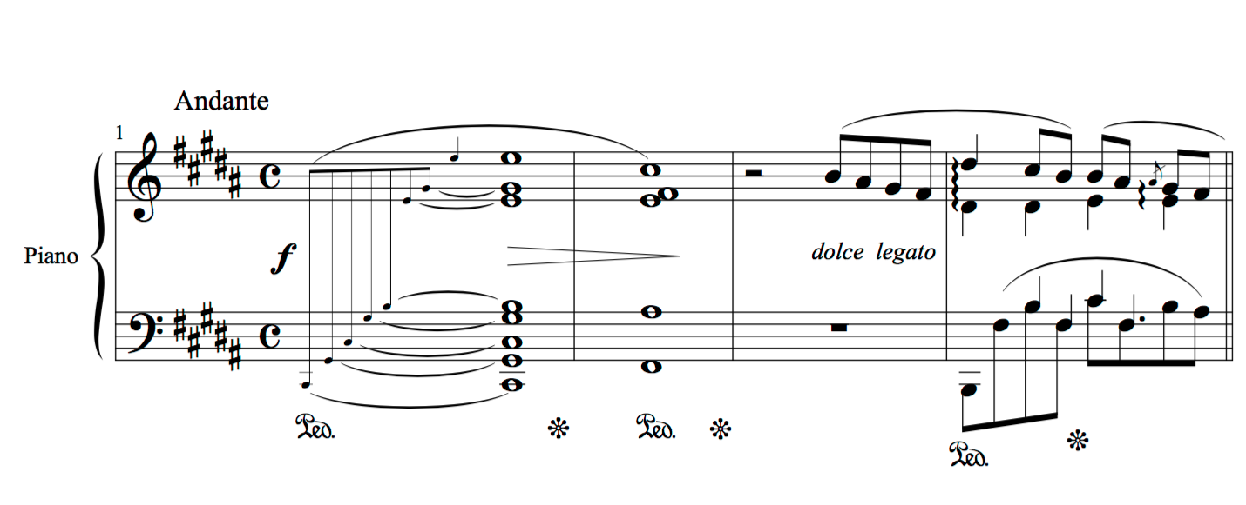
Chopin, Nocturne in B Major, op. 62 no. 1

Slide 8
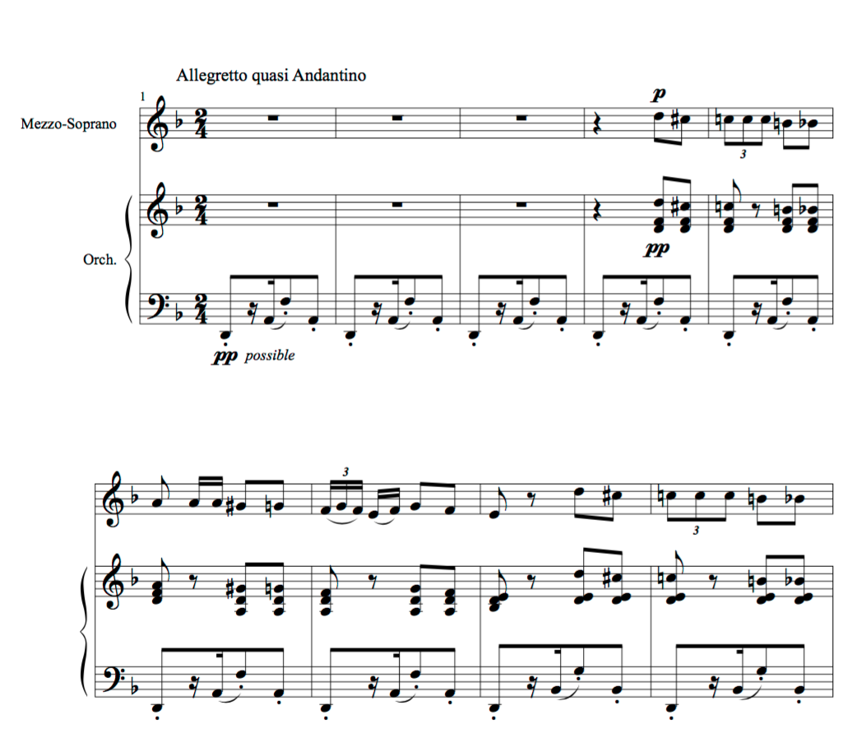
Bizet, Carmen, Act I no. 5, Habañera

Slide 9
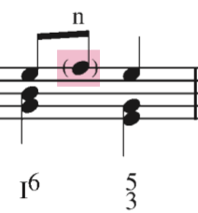
Neighboring Tones
The neighboring tone is used to embellish a single tone, which is heard both before and after the neighbor.
A neighboring tone is approached by step and left by step in the opposite direction
Put the note in parentheses, and label with a n
Further descriptors:
Upper/lower
Diatonic/chromatic
Accented/unaccented
Unaccented, diatonic, upper neighboring tone

Slide 10
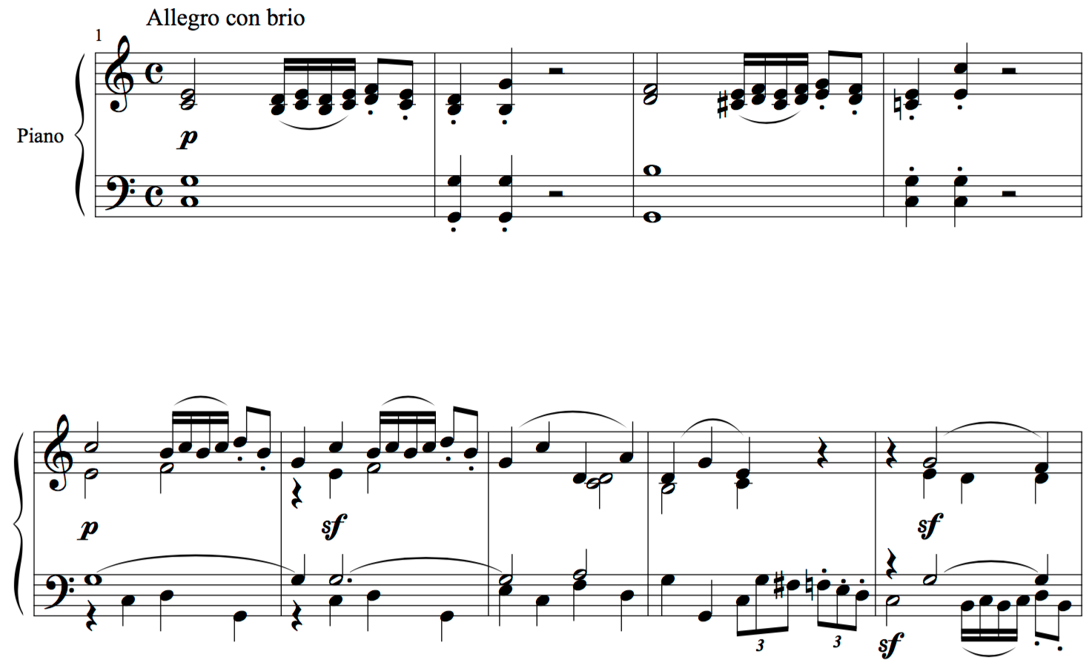
Beethoven, Piano Sonata in C Major, op. 2 no.3, mvt. 1

Slide 11
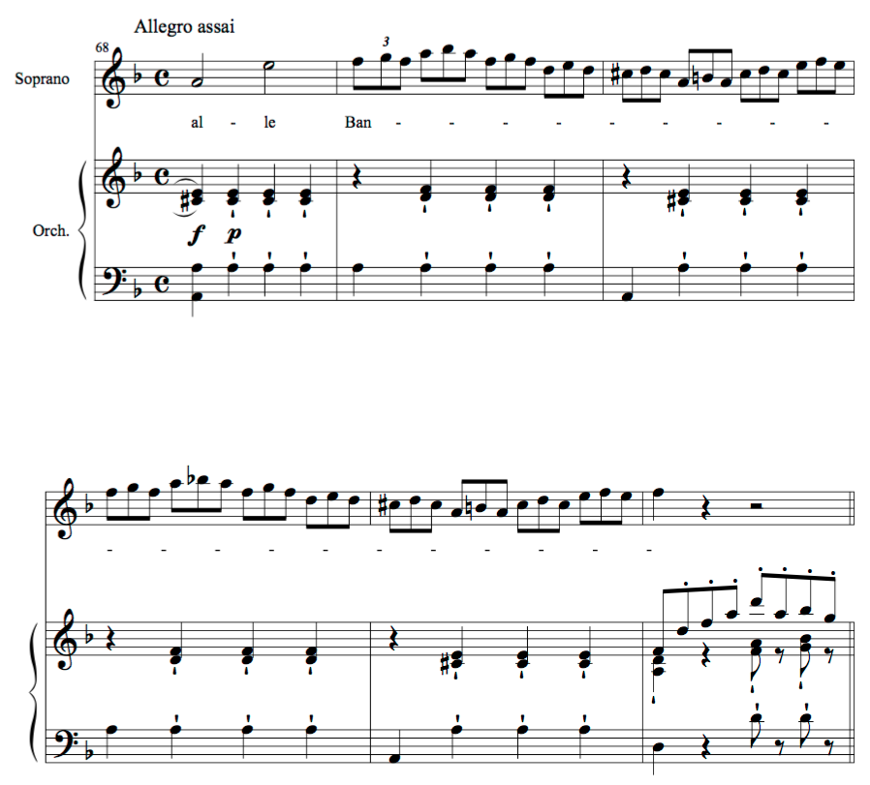
Mozart, The Magic Flute, K. 620, Act II, "Queen of the Night Aria"

Slide 12
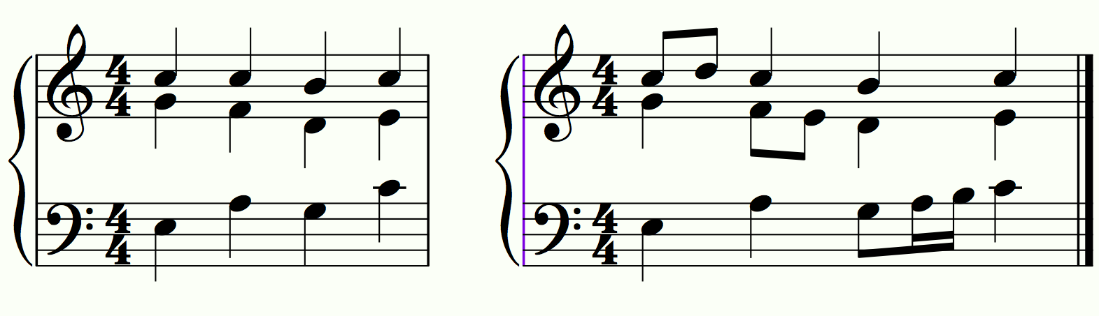
Part writing w/ NCTs
We can use NCTs to embellish simple textures.
But we must be careful to avoid objectionable parallels

Slide 13
NCT Review
Passing Tones
Approached and left by step in the same direction
Often fills in a major or minor third with whatever scale degree is in between.
Neighboring Tones
Approached and left be step in opposite directions
Embellishment of a single tone

Slide 14
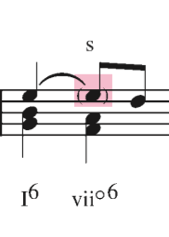
Suspensions
“to hang something from somewhere”
Suspension: holds on to, or suspends, a chord tone after other parts have moved on to the next chord.
The suspension always resolves down by step
Labeled with an “s”

Slide 15
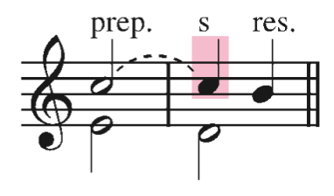
Parts of a Suspension
Each suspension has three parts:
Preparation
the tone preceding the suspension, and it is the same pitch as the suspension
Suspension
May or may not be tied to the prep.
Resolution
the tone following the suspension and lying a 2nd below it

Slide 16
Classification of Suspensions
We categorize suspensions by the harmonic intervals created by the suspended tone and the resolution
If there are more than two parts, the interval is calculated between the suspension and the bass voice.
If the suspension occurs in the bass, we calculate the interval between the bass voice and the part with which it is most dissonant
7 - 6

Slide 17
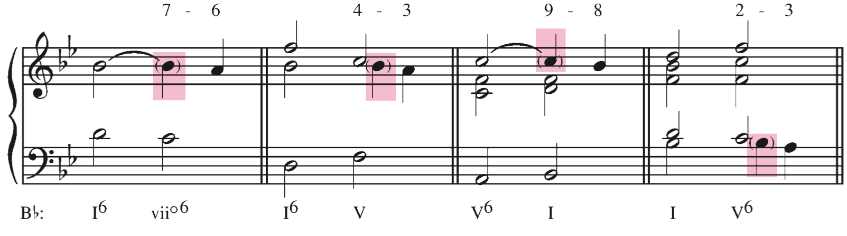
Common Suspensions
The number of the suspension is always decreasing, unless…...
The suspension
in the bass voice

Slide 18
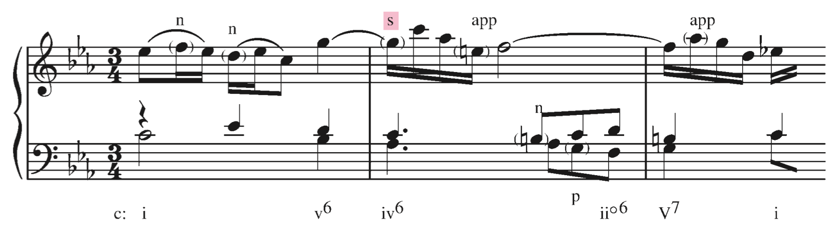
More on Suspensions
Suspensions are often embellished.
Other tones may appear after the suspended tone but before the true resolution
These are called suspension figures
suspension with change of bass: When a suspension occurs in one of the upper voices, the bass will sometimes move on to another chord tone at the same time as the suspension resolves.

Slide 19
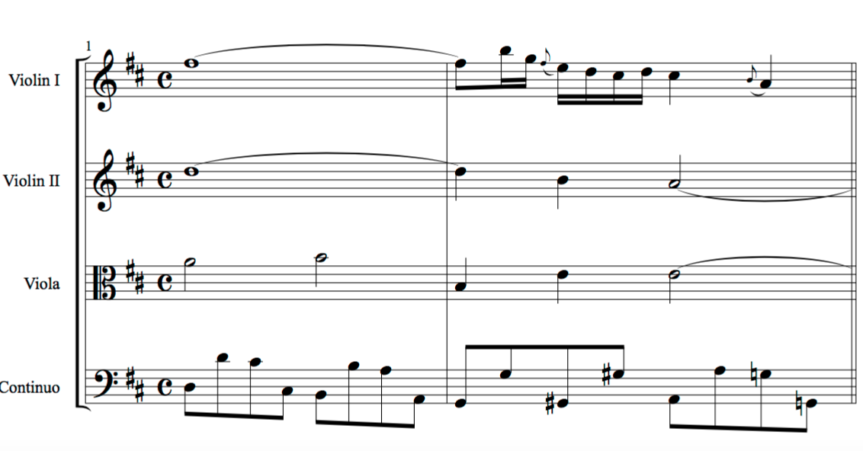
Bach, Orchestral Suite No. 3

Slide 20
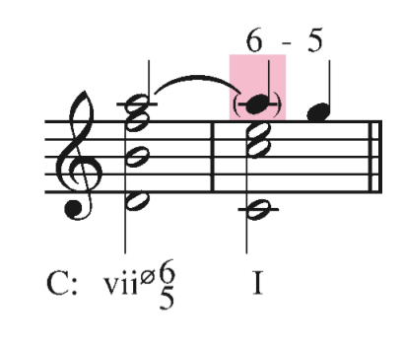
Consonant Suspensions
A suspension does not always have to be with a dissonant note.
For example:

Slide 21
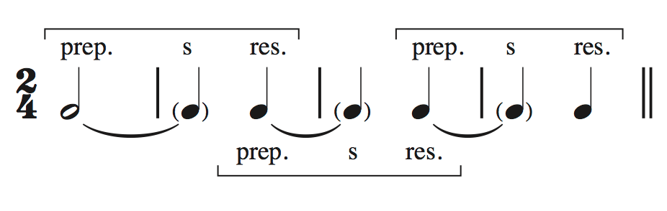
Chain of Suspensions
A resolution of a suspension can serve as the preparation for a following suspension.

Slide 22
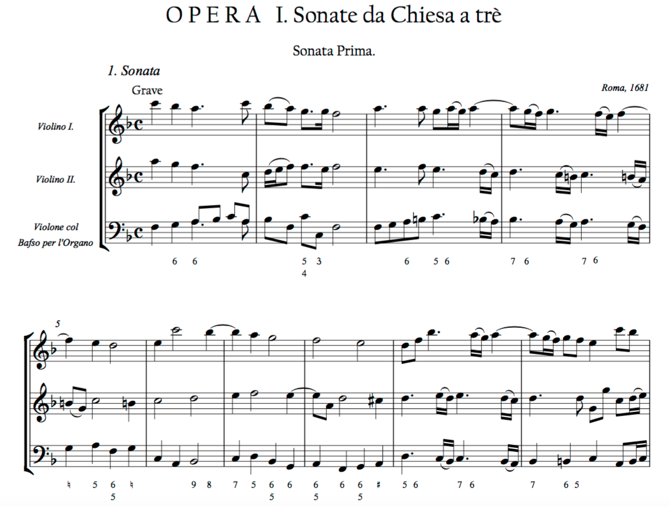

Slide 23
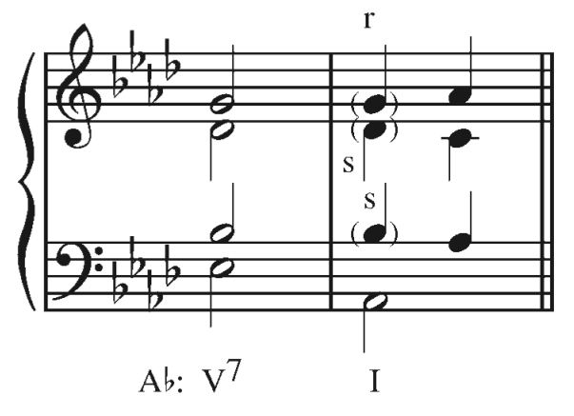
Retardations
Retardation: holds on to, or retards, a chord tone after other parts have moved on to the next chord.
A retardation always resolves upward by step.
This is simply a suspension with an upward resolution.
Commonly appears with suspensions in cadences in the Classical Style:

